Slide 1
Number System

Slide 2
Binary Number System
Digits: 0, 1
Decimal Number System
Digits: 0, 1, 2, 3, 4
5, 6, 7, 8, 9
Hexadecimal Number Systems
Digits: 0, 1, 2, 3, 4, 5, 6, 7,
8, 9, A, B, C, D, E, F

Slide 3
Decimal | Binary | Hexadecimal
0 | 0000 | 0
1 | 0001 | 1
2 | 0010 | 2
3 | 0011 | 3
4 | 0100 | 4
5 | 0101 | 5
6 | 0110 | 6
7 | 0111 | 7
8 | 1000 | 8
9 | 1001 | 9
10 | 1010 | A

Slide 4
Decimal | Binary | Hexadecimal
11 | 1011 | B
12 | 1100 | C
13 | 1101 | D
14 | 1110 | E
15 | 1111 | F
16 | 10000 | 10
17 | 10001 | 11
18 | 10010 | 12
19 | 10011 | 13
20 | 10100 | 14
21 | 10101 | 15

Slide 5
Converting Decimal to Binary Number
Convert 5₁₀ to binary number
Divide 5 by 2 => Quotient = 2, Remainder = 1
Divide 2 by 2 => Quotient = 1, Remainder = 0
Divide 1 by 2 => Quotient = 0, Remainder = 1
5₁₀ is represented in binary as 101₂

Slide 6
Converting Decimal to Binary Number
Convert 10₁₀ to binary number
Divide 10 by 2 => Quotient = 5, Remainder = 0
Divide 5 by 2 => Quotient = 2, Remainder = 1
Divide 2 by 2 => Quotient = 1, Remainder = 0
Divide 1 by 2 => Quotient = 0, Remainder = 1
10₁₀ is represented in binary as 1010₂

Slide 7
Converting Decimal to Hexadecimal Number
Convert 10₁₀ to hexadecimal number
Divide 10 by 16 => Quotient = 0, Remainder = 10
10₁₀ is represented in hexadecimal as A₁₆
Note: In hexadecimal number system 10 is represented with digit A

Slide 8
Converting Decimal to Hexadecimal Number
Convert 1500₁₀ to hexadecimal number
Divide 1500 by 16 => Quotient = 93, Remainder = 12
Divide 93 by 16 => Quotient = 5, Remainder = 13
Divide 5 by 16 => Quotient = 0, Remainder = 5
1500₁₀ is represented in hexadecimal as 5DC₁₆ OR 0x5DC

Slide 9
Converting Binary to decimal Number
Convert 1010₂ to decimal number
1010
= 1 * 2³ + 0 * 2² + 1 * 2¹ + 0 * 2⁰
= 8 + 0 + 2 + 0
= 10
1010₂ is represented in decimal as 10₁₀

Slide 10
Converting Binary to Hexadecimal Number
Convert 101011101₂ to hexadecimal number
Now refer to the table
1 5 D
101011101₂ is represented in hexadecimal as 15D₁₆
0001 | 0101 | 1101

Slide 11
Converting Hexadecimal Number To Binary
Convert 15D₁₆ to Binary number
Now refer to the table
15D₁₆ is represented in binary as 101011101₂
1 | 5 | D
0001 | 0101 | 1101

Slide 12
Converting Hexadecimal Number To Decimal
Convert 15D₁₆ to Decimal number
= 15D
= 1 * 16² + 5 * 16¹ + 13 * 16⁰
= 256+ 80 + 13
= 349
15D₁₆ is represented in binary as 349₁₀

Slide 13
How integer is stored in 4 bytes
1 byte = 8-bit 4 byte = 32-bit
Each byte will have an address (refer to slide-15)
For n-bit, 2^{n} possible values
Unsigned, 0 to 2^{n-1}
Signed, -(2^{(n-1)}-1) to (2^{n-1})

Slide 14
The sign bit
The left-most bit, more formally known as Most Significant Bit (MSB) is used to determine the sign of the integer.
If sign bit is 0 = positive or zero int If sign bit is 1 = negative int

Slide 15
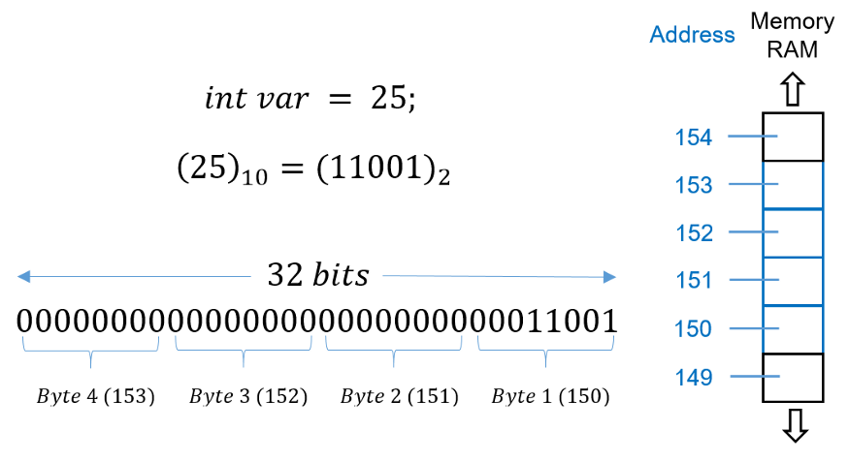

Slide 16
Range of numbers in different data types
Type | Size | Range
int | 4-bytes | -2³¹ to (2³¹-1)
int (unsigned) | 4-bytes | 0 to 2³²-1
long long | 8-bytes | -2⁶³ to 2⁶³-1
long long (unsigned) | 8-bytes | 0 to 2⁶⁴-1

Slide 17
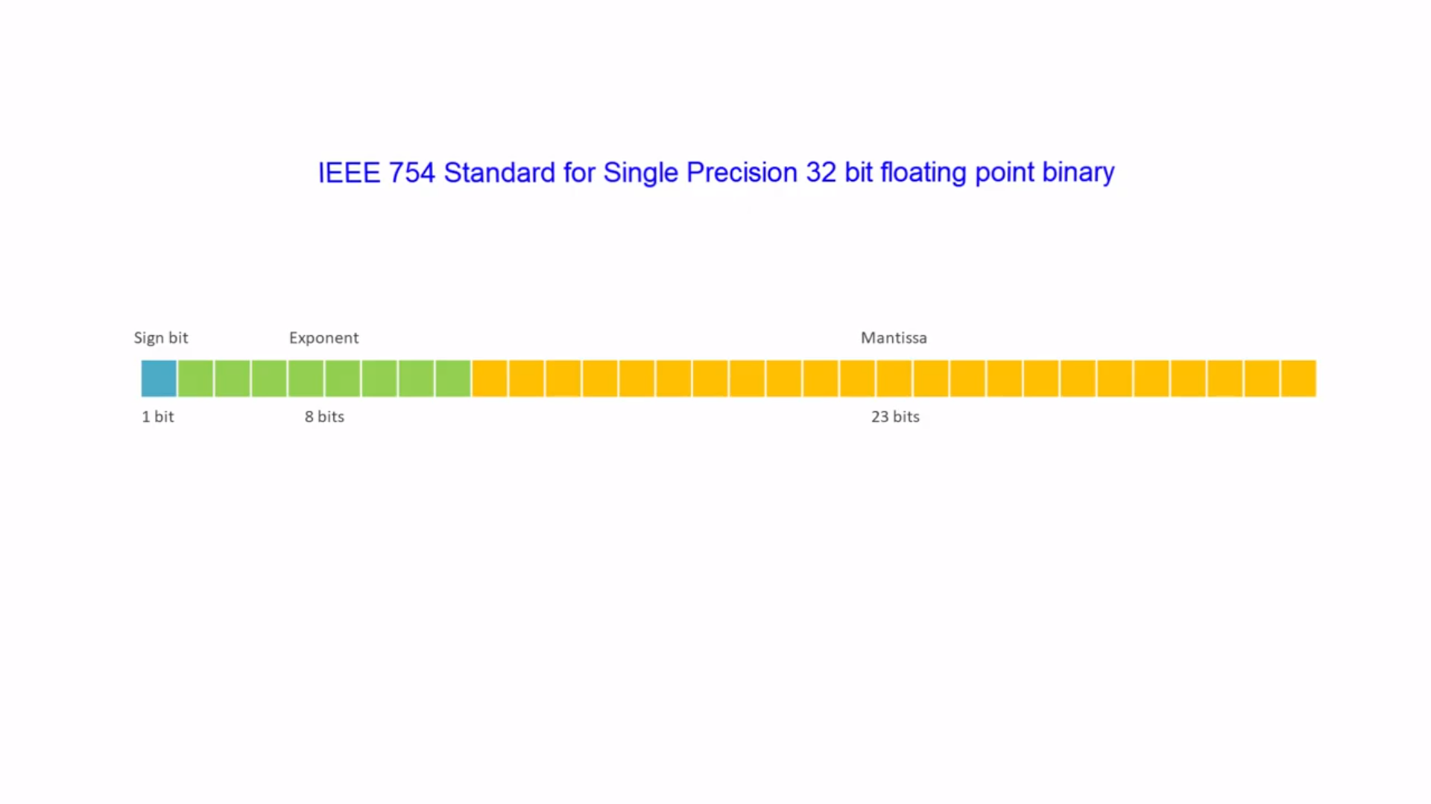
How FLoating-Point number is stored in 4 bytes

Slide 18
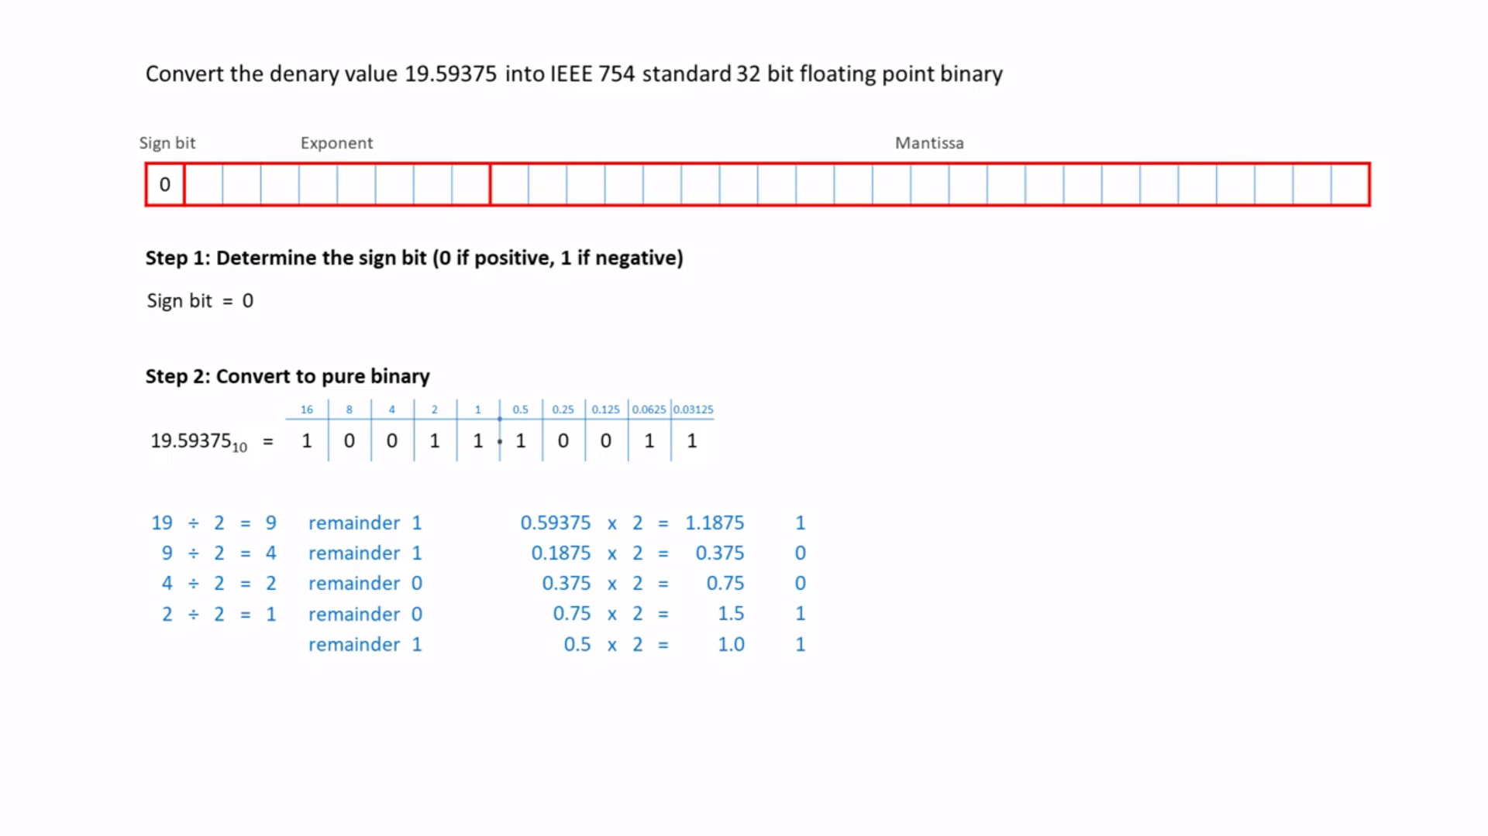
10011 . 10011
Stop when the fraction is zero

Slide 19
